Slide 1
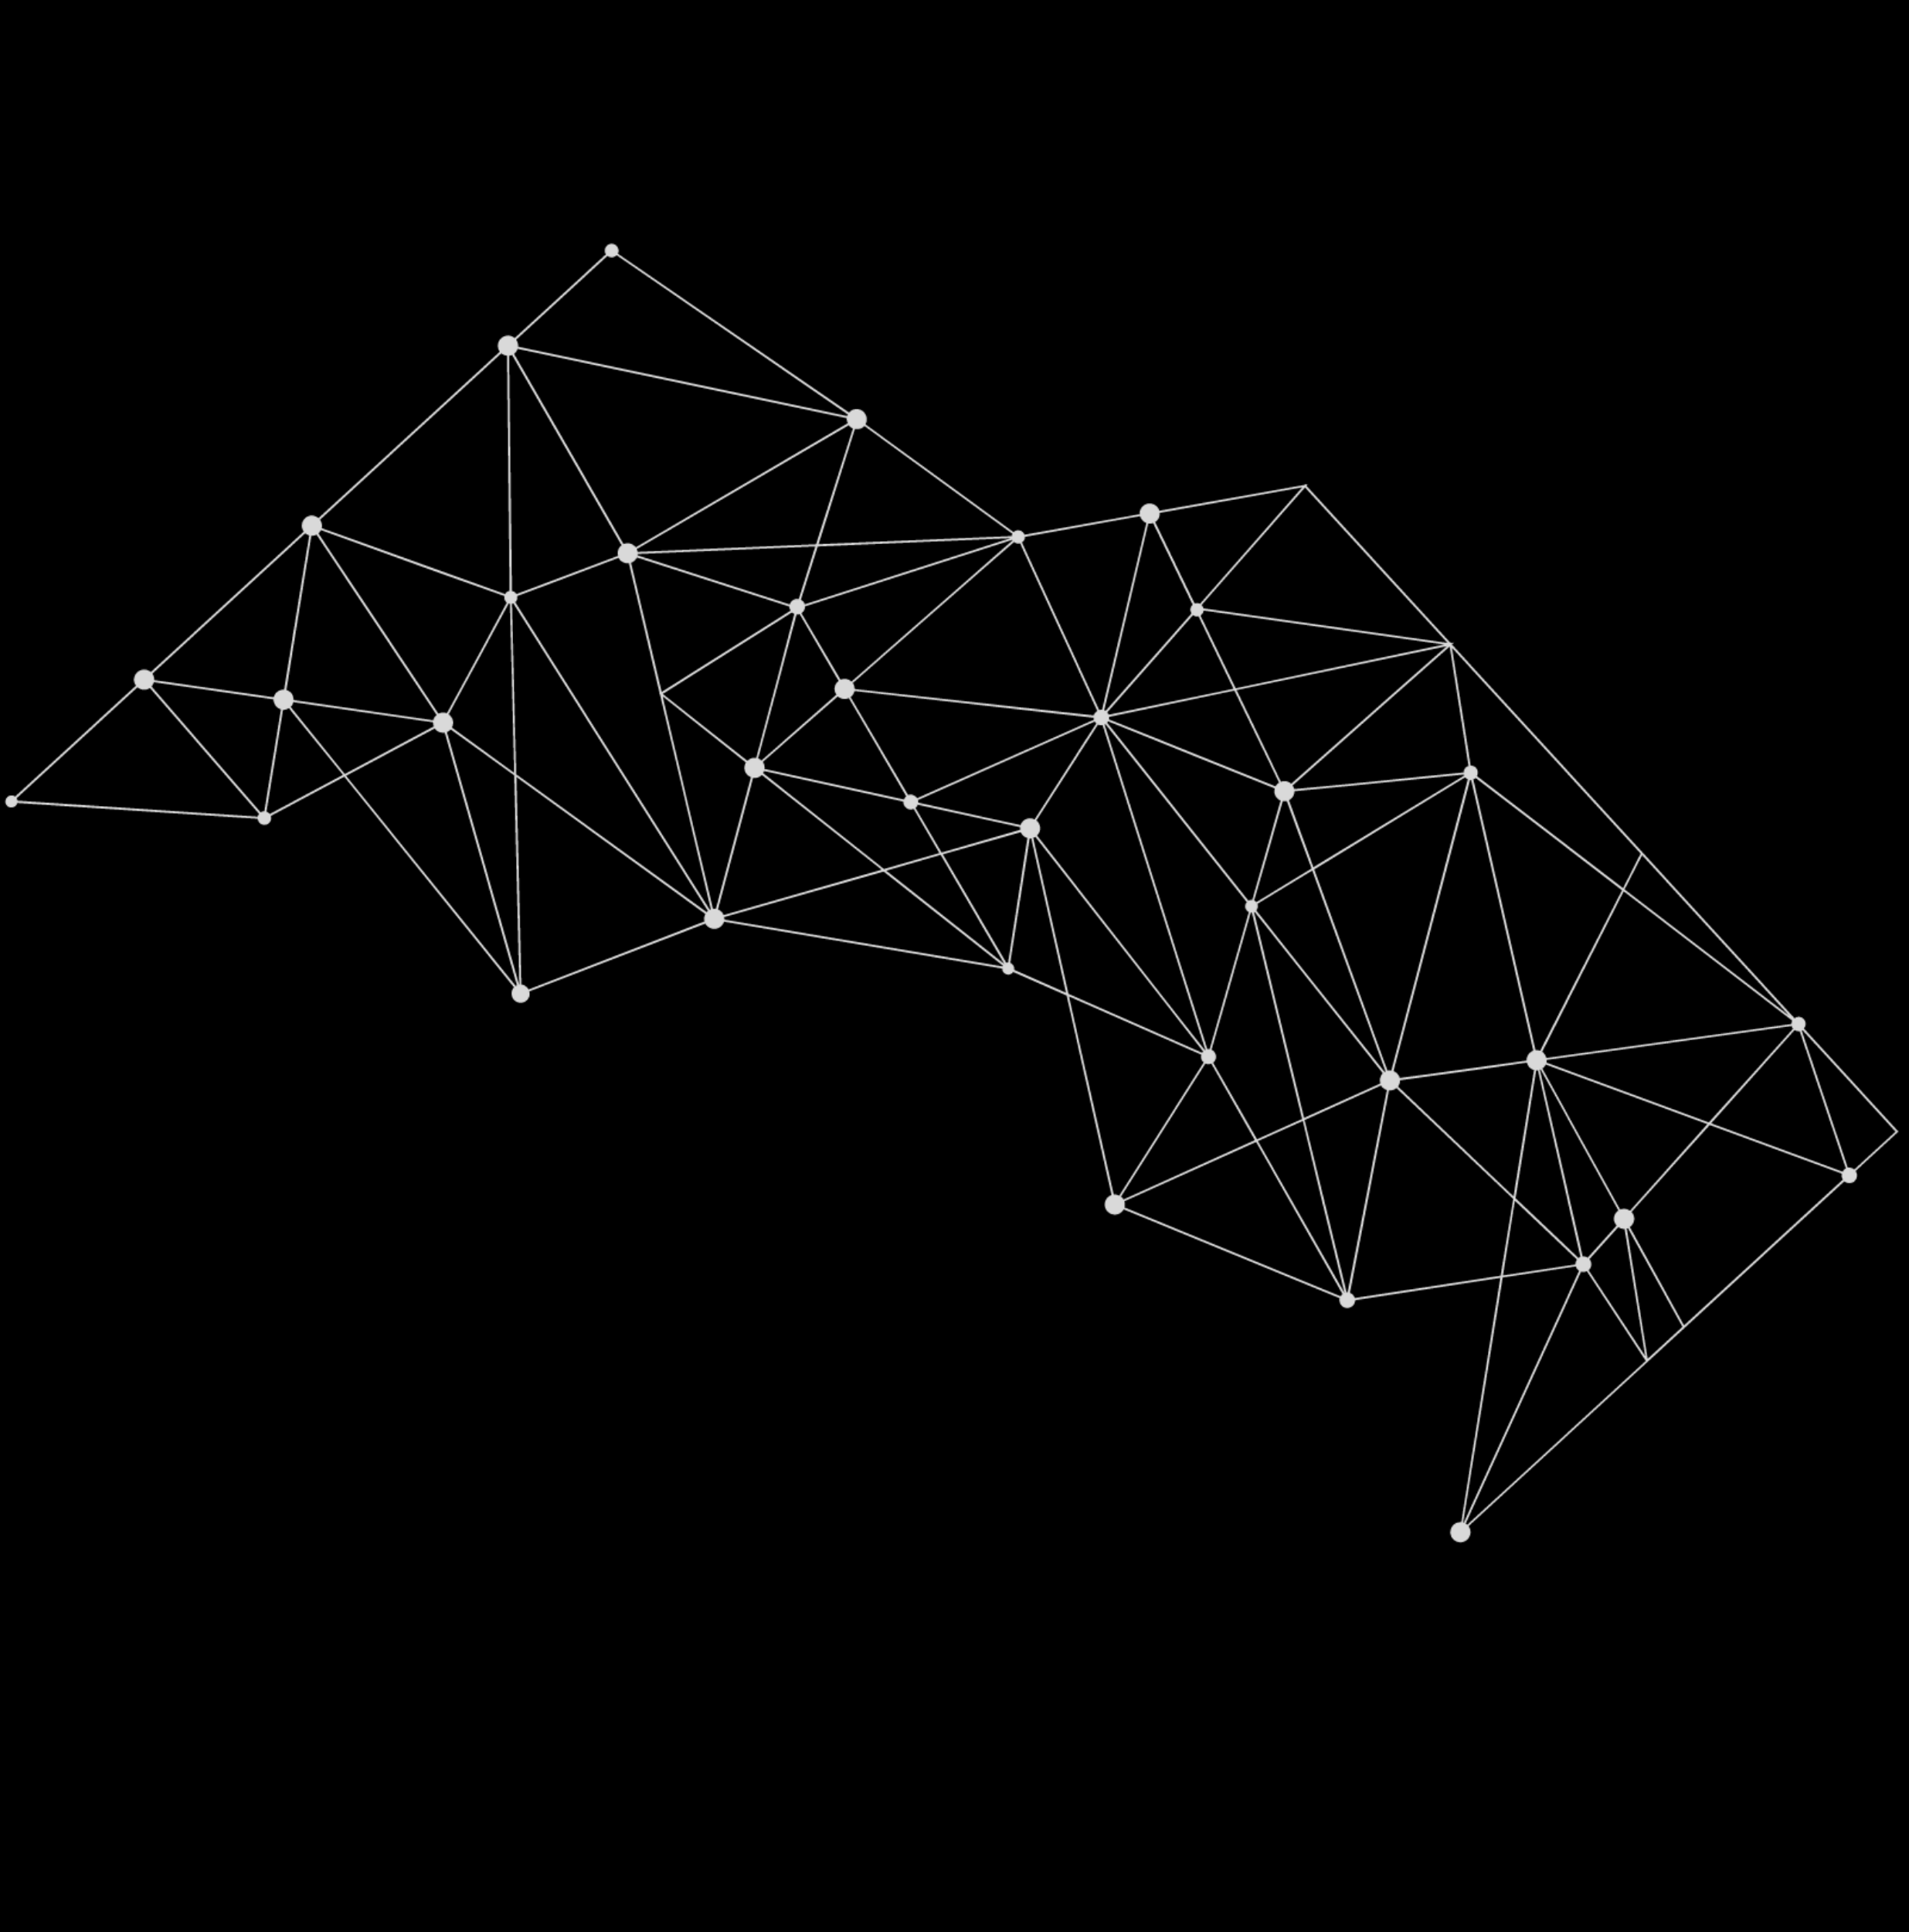

AI-GIS BASED MOBILE APPLICATIONS FOR TRACKING DEEP SEA FISHERMEN
AVC COLLEGE OF ENGINEERING
Department Of Electronics And Communication
Presented by
S.SIVAPRIYA (820320106022)
G.UDHAYA (820320106026)
S.VISHWAJA (820320106029)
GUIDE NAME:DR.C.JAYASRI

Slide 2

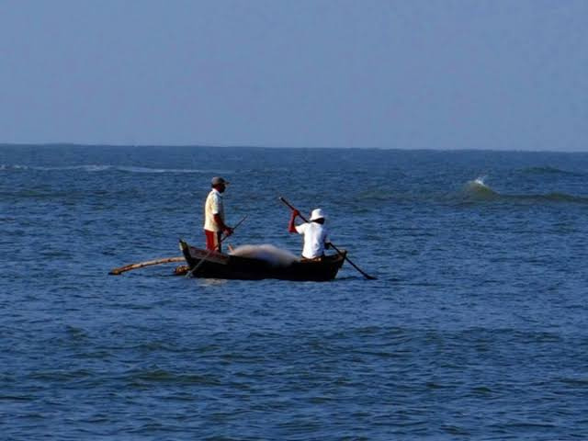
Abstract
Deep-sea locations often lack reliable and continuous communication infrastructure, making it challenging to establish real-time tracking systems. Developing a technology that can operate in low-connectivity areas is crucial. The primary goal is to create an AI based Geographic Information System (GIS) app capable of accurately detecting and tracking the locations of deep-sea fishermen during their maritime activities.Theproposed solution leverages advanced Artificial Intelligence and Machine Learning algorithms to analyze relevant data and provide real-time location information. The GIS app aims to offer a comprehensive and user-friendly interface for effective monitoring, ensuring the safety of fishermen in remote fishermen and challenging deep-sea environments. The expected result is an innovative GIS app that significantly improves the tracking capabilities in deep-sea fishing, contributing to enhanced safety measures and efficient maritime activities. This project addresses a critical aspect of maritime safety and strives to make a positive impact on the well-being of deep-sea fishermen.

Slide 3


Objectives
•Design and implement a robust real-time location tracking system capable of accurately pinpointing the locations of deep-sea fishing vessels.
•Achieve a high level of accuracy and precision in location data to enable reliable monitoring and navigation for deep-sea fishermen.
•Improve emergency response capabilities by developing features that quickly relay distress signals and real-time location data to relevant authorities for prompt search and rescue operations.
•Design an intuitive and user-friendly interface to ensure that the technology is accessible to a wide range of users, including fishermen with varying levels of technological expertise.
•By using this we can reduce the missing rates of fishermen and boats.

Slide 4
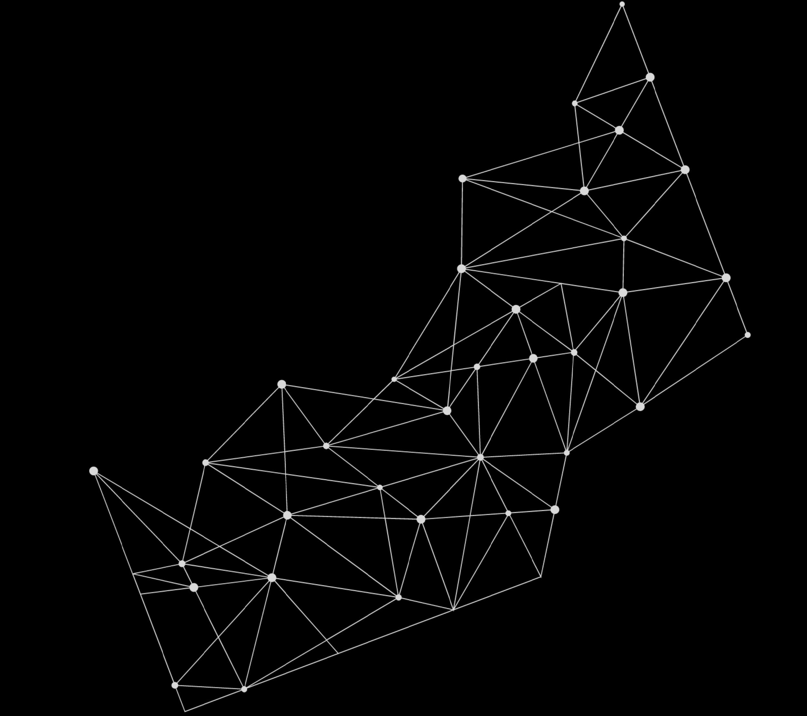

Introduction
•In the vast expanses of the open sea, deep-sea fishermen navigate through challenging environments to harvest marine resources critical for sustenance and economic livelihoods.
•However, the inherent risks and uncertainties of deep-sea fishing demand innovative solutions to ensure the safety of fishermen and enhance the overall effectiveness of maritime activities.
•Developing a suitable technology for tracking deep-sea fishermen or their locations stands as a pivotal challenge in promoting both safety and efficiency in this crucial sector.
•This initiative seeks to explore and develop a technology that not only tracks the whereabouts of deep-sea fishermen but also ensures effective monitoring and enhances safety measures in maritime activities.
•By leveraging advancements in artificial intelligence, machine learning, and geospatial technologies, we aim to create a robust system capable of providing accurate, real-time location data, predicting potential risks, and facilitating proactive decision-making for both fishermen and relevant authorities

Slide 5
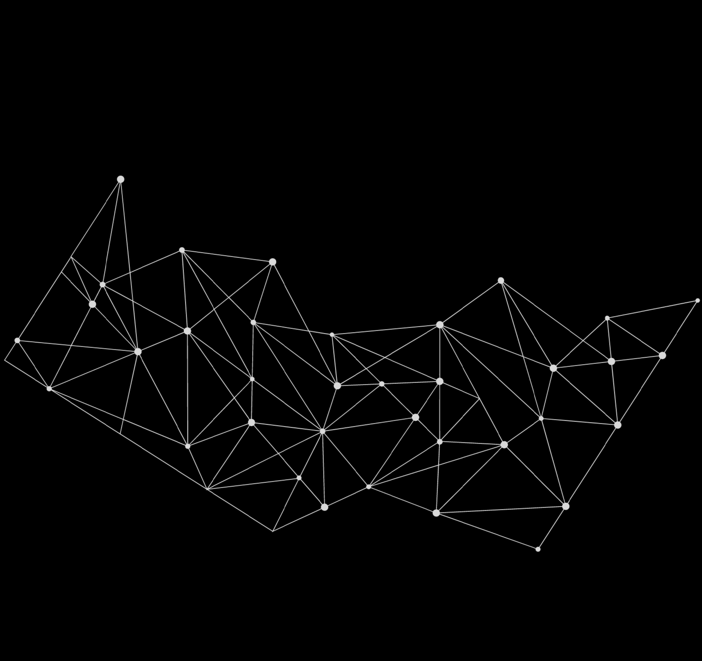
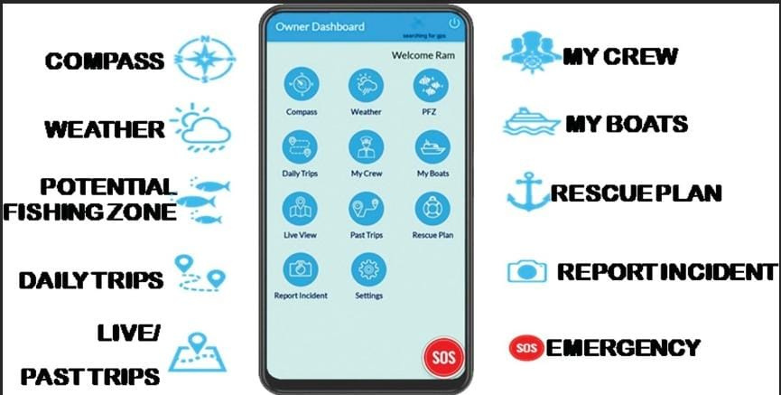
Existing System
In the existing system there are many things to find such as weather conditions,compass,tide heights.
Some of the apps are tide ,Fish rolls,wind finder, fishing knots.
Proposed System
In this project we came up with solutions for the missing of fishermen.
In this system the fishermen should preregister his details and incase of emergency they should click the sos.
Using the technique AI will indicate the location of the stucked fishermen via SMS to the nearby fishermen or to the fleet.

Slide 6
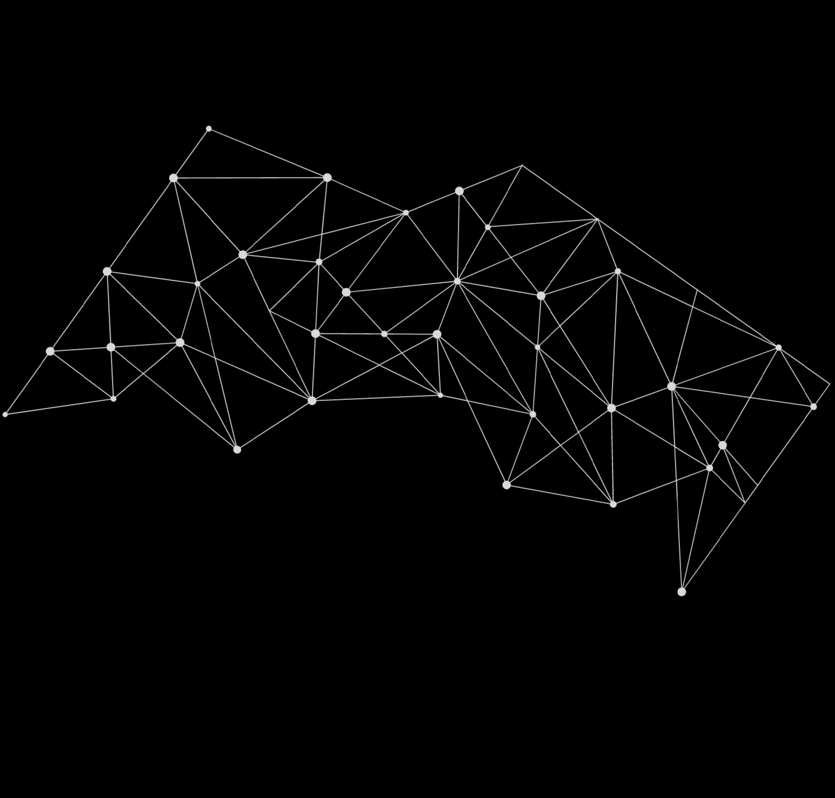
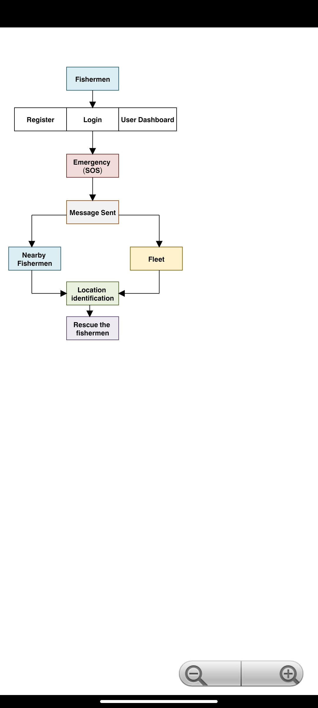
Block Diagram

Slide 7

Advantages
These applications provide real-time tracking of fishing vessels, enabling authorities and stakeholders to monitor the movement and location of vessels continuously.
Mobile applications facilitate seamless communication between fishermen, authorities, and other stakeholders. They can receive alerts, updates on regulations, weather forecasts, and emergency notifications directly through the app, improving communication efficiency and coordination.
It can assist in enforcing fishing regulations by tracking vessels' activities and ensuring compliance with fishing quotas, protected areas, and seasonal restrictions. AI can flag suspicious behavior or illegal fishing activities for further investigation.
﻿AI algorithms integrated into GIS can analyze historical data, weather patterns, and oceanographic conditions to suggest optimized routes for fishermen, enhancing fuel efficiency and reducing the risk of encountering hazardous conditions.

Slide 8
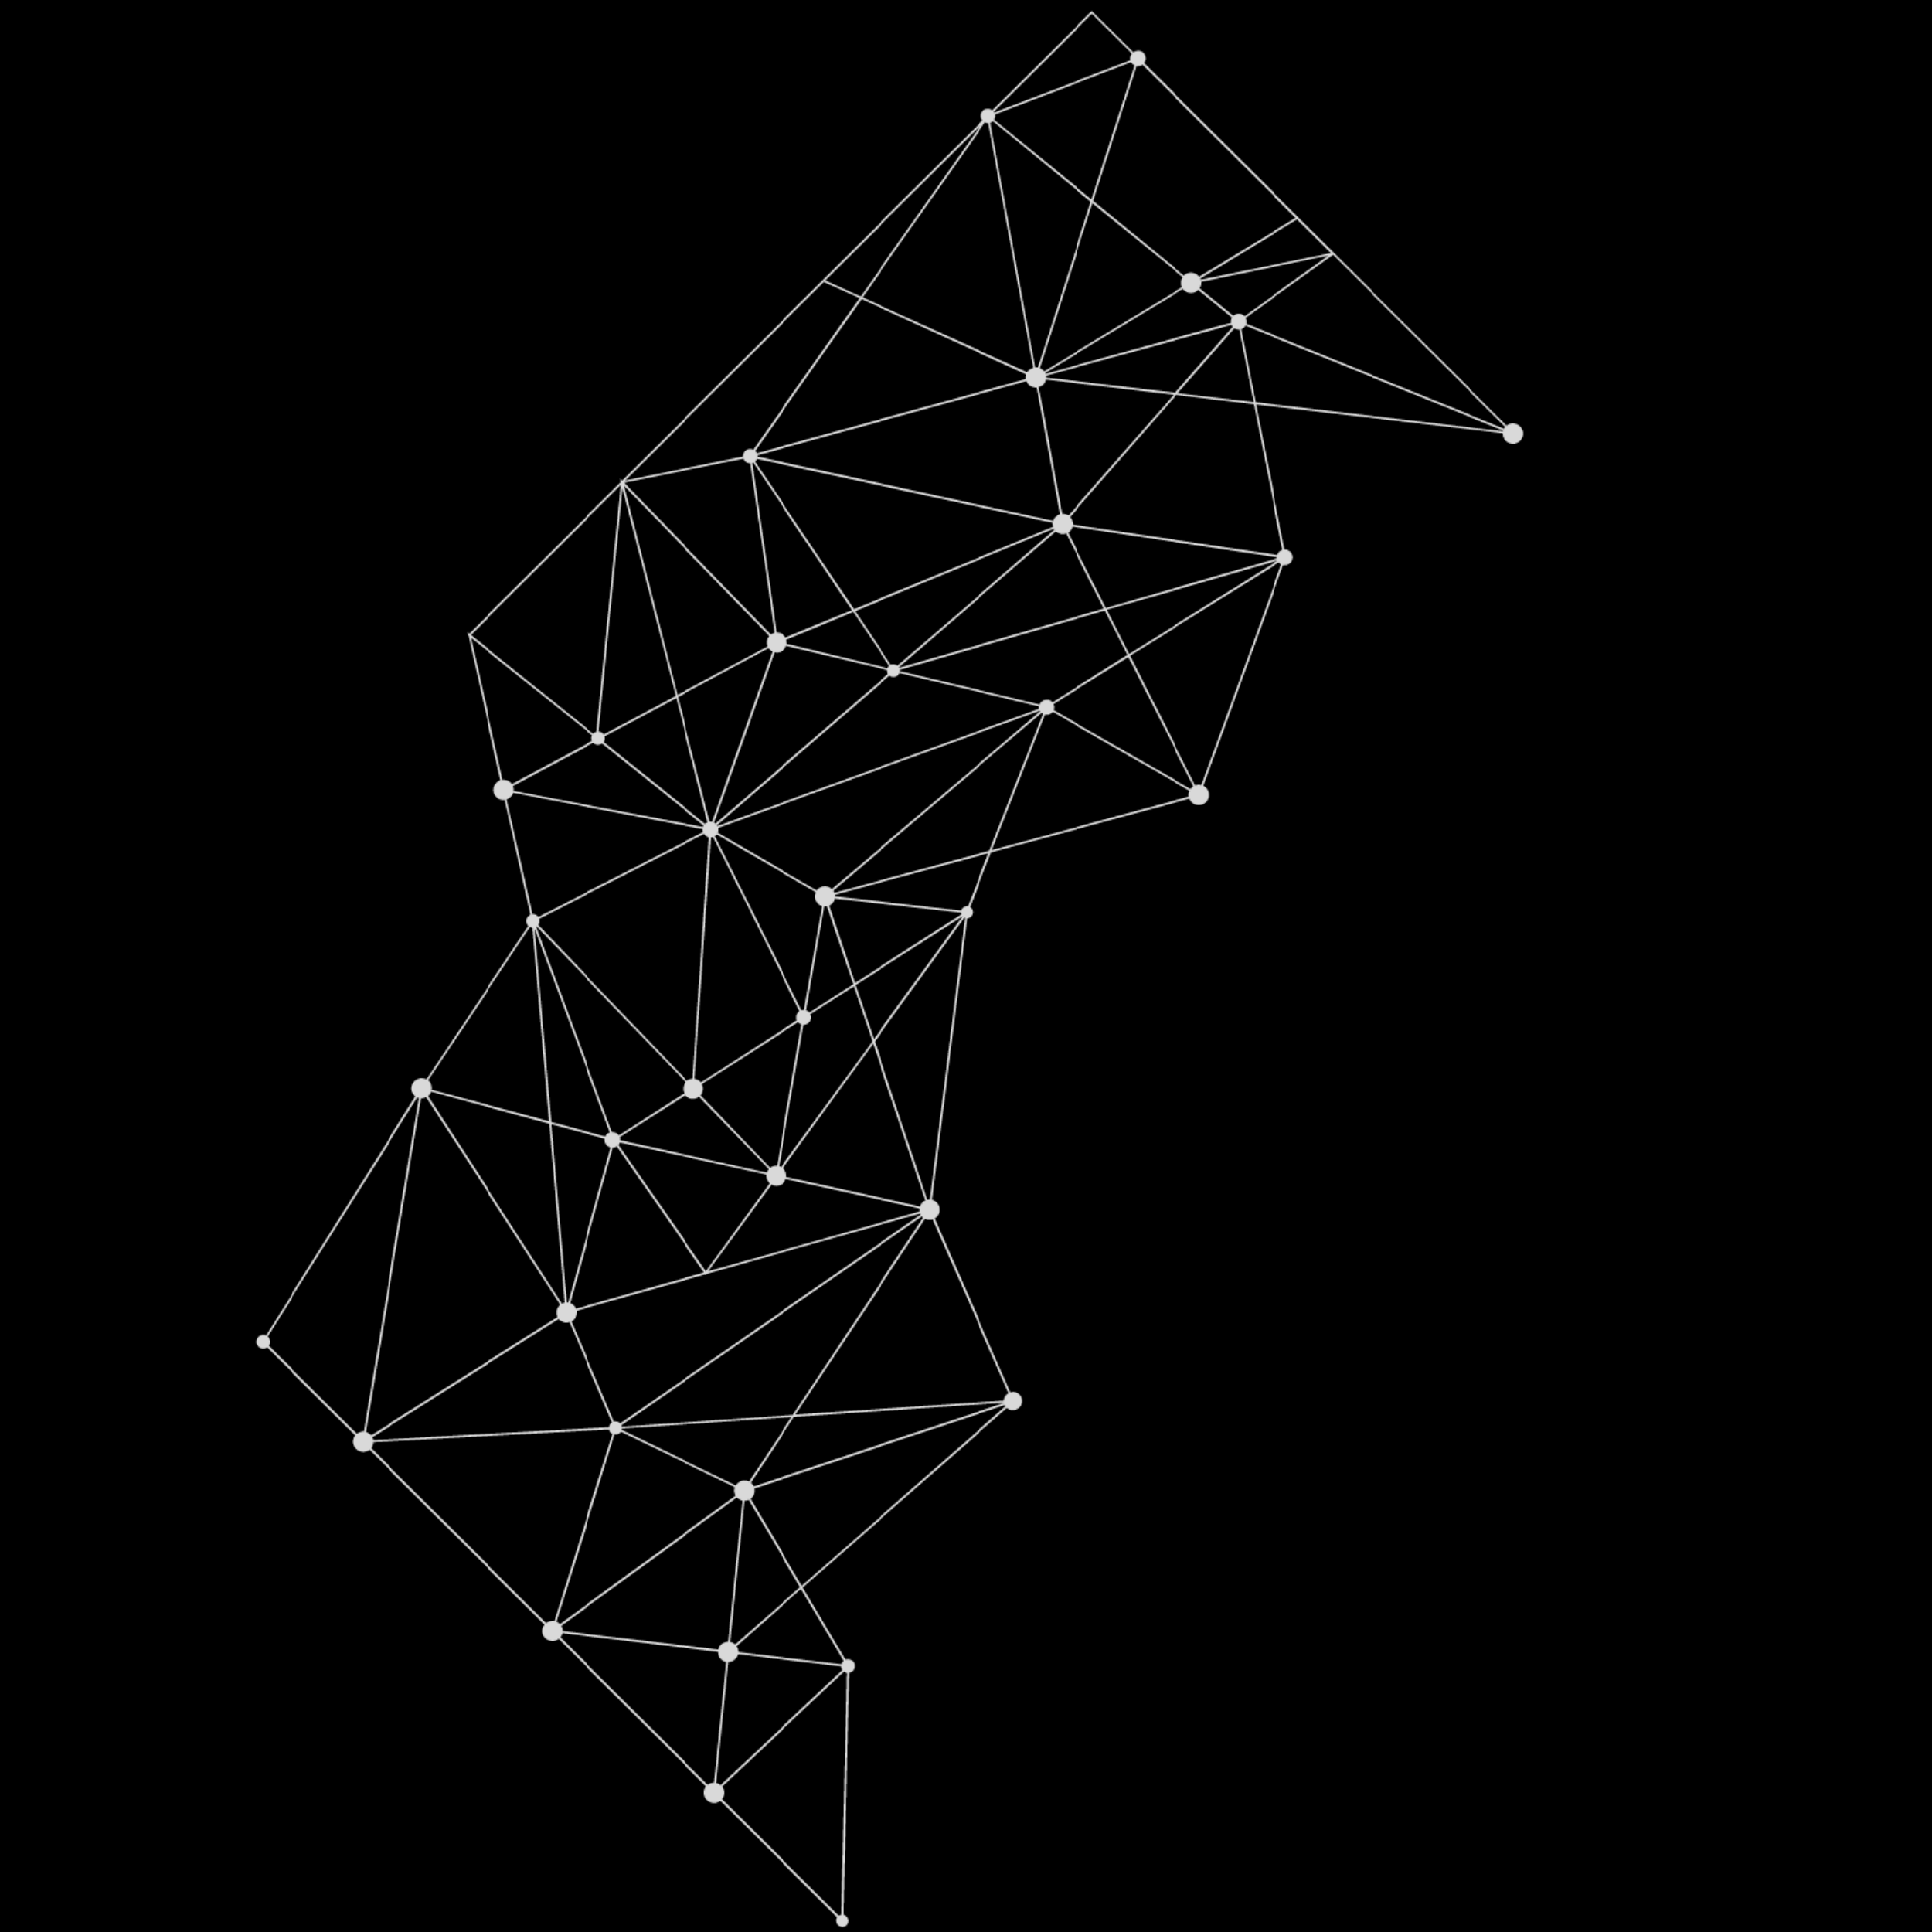

Reference
1. Arpita Sharma, Dhenuvakonda Kiranmayi(2019), Virtual Fisheries through mobile app-the way forward.https://www.researchgate.net/publication/338039156_Virtual_fisheries_through_mobile_apps_The_way_forward
2. Arunvijay, D., & Yuvaraj, E. 2014. Design of border alert system for ﬁshermen using GPS. Int J Students Res Technol Manag. 2(02):67-70.
3. Darshan. A. S, Mahir. M. M, Mayur. R(2014), Design and development of low cost navigation and security systems for Indian fishermen.
https://www.researchgate.net/publication/274256860_Design_and_Development_of_Low_Cost_Navigation_and_Security_System_for_Indian_Fishermen
4. Sujith Kumar Saka, Aleena Elsa Mathew, Vivek Ganesh (2021), A web-GIS and mobile based application for a safe ocean for fishers. Marine Technology Society Journal 55(3):50-57
DOI:10.4031/MTSJ.55.3.10.

Slide 9
THANK YOU!

